Slide 1
TBA Schedules

Slide 2
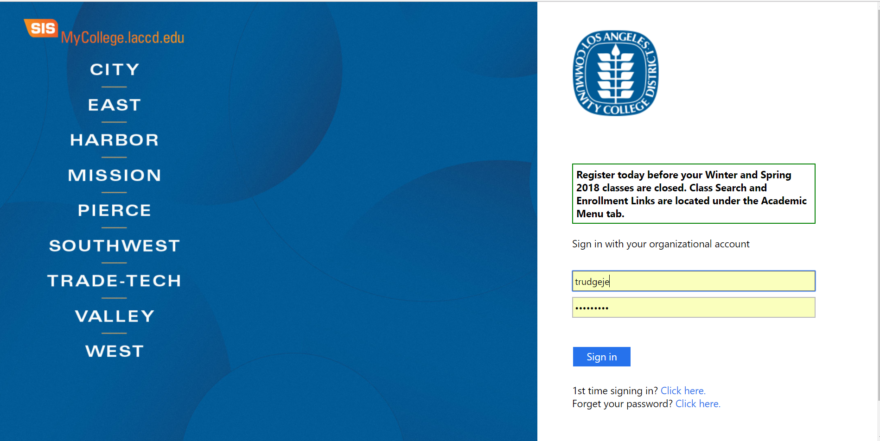
Login to your faculty portal

Slide 3
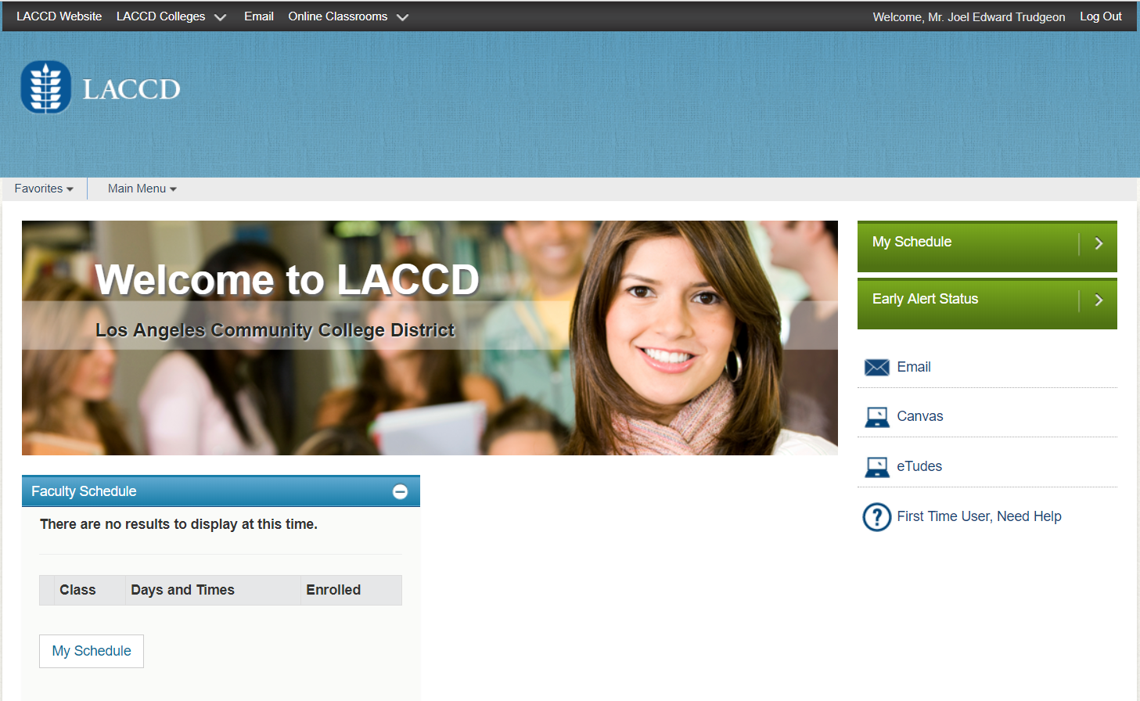
Click on My Schedule to select your class

Slide 4
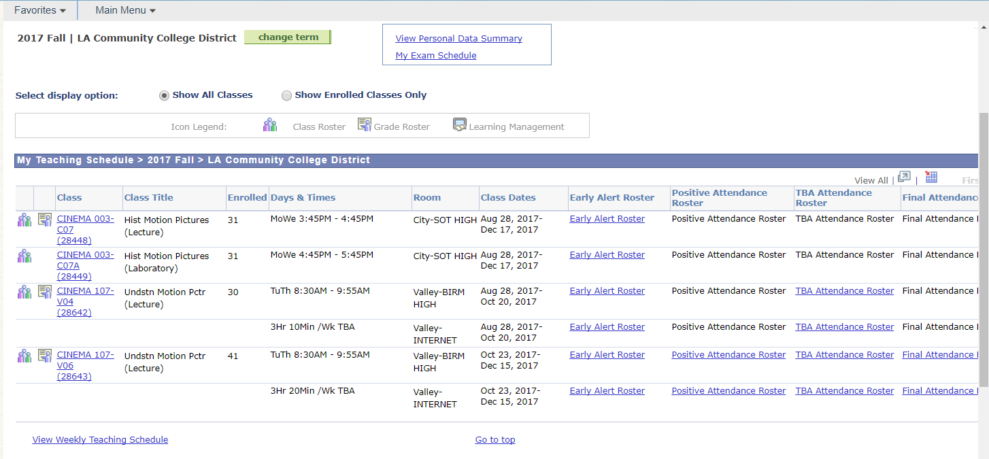
Select the Class you are scheduling TBA

Slide 5
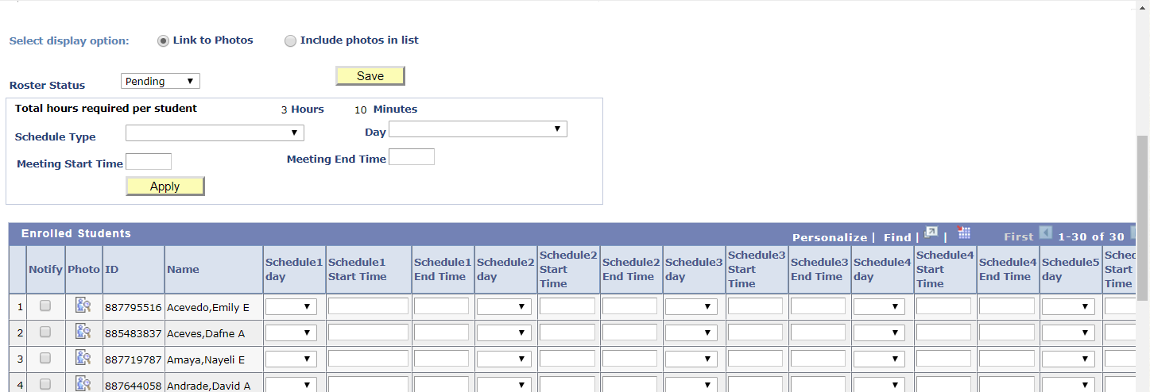
1. Enter the schedule 2. Select meeting day(s) 3. Enter the meeting start and end times 4. Click Apply -- It will apply to all students.
1
2
3

Slide 6
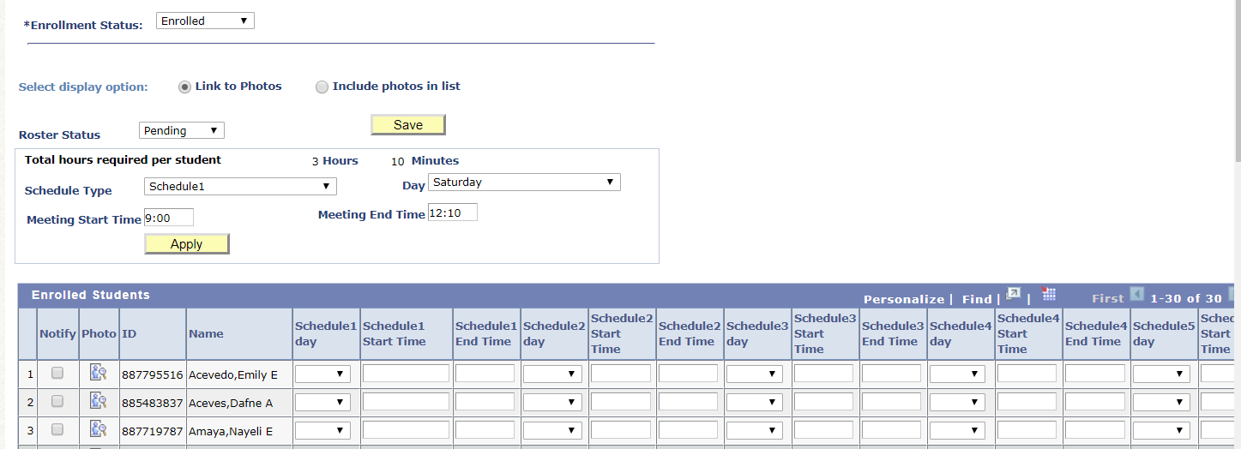
Now you have created a schedule. CLICK Apply to apply the schedule to your entire class roster.

Slide 7
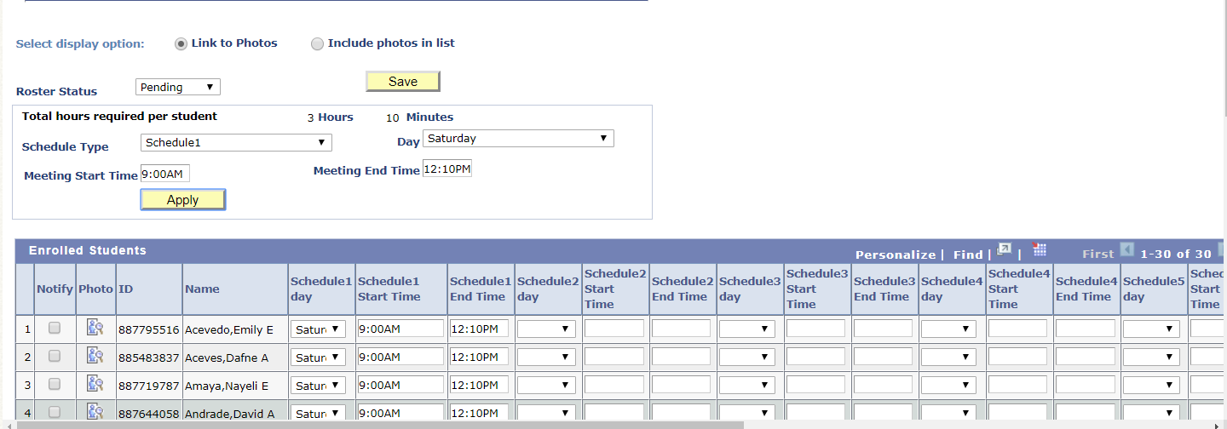
Schedule 1 has been applied to ALL students If you need to add additional schedules, you will need to individually remove Schedule 1 and enter Schedule 2.

Slide 8
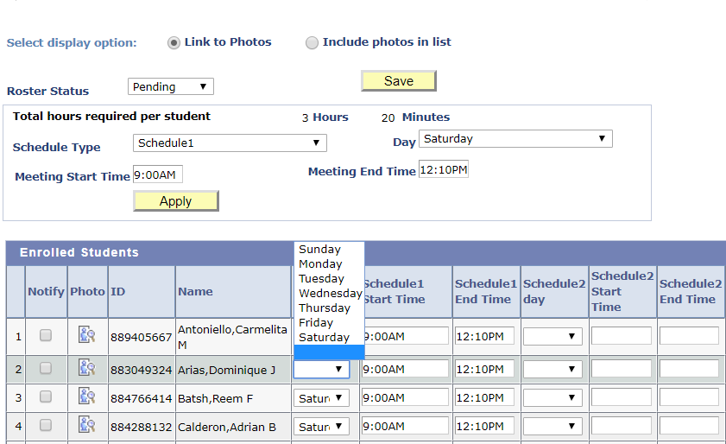
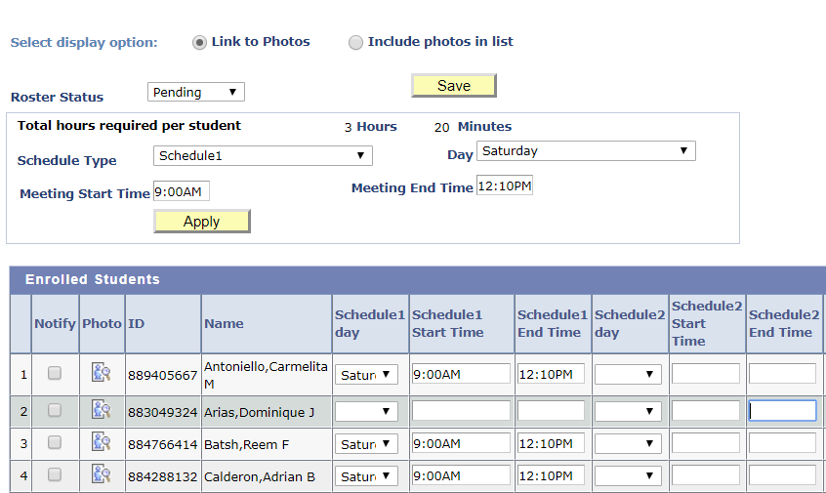
Manually remove Schedule 1 by making the day of the week blank and deleting the start and end times. Manually enter Schedule 2 by: Selecting the day from the pull down menu Entering the meeting start and end times.

